Slide 1
Practical Machine Learning
using
Apache Spark
Joy Chakraborty
April 13, 2017
Email: joychak1@[yahoo/gmail].com]]

Slide 2
Who am I ???
I learn and apply ….
- Design and write software for living
- for last 17 years …

Slide 3
Follow me at -
https://github.com/joychak/spark-prediction

Slide 4
Disclaimer
Not much of Machine Learning theory or Math
Not an Artificial Intelligence presentation
Covered Machine Learning basics for Software Engineering only
Introducing various concepts required to fulfil the job as machine learning programmer.
Domain specific discussion - only what demo demands

Slide 5

Agenda
1
Machine Learning Basics for Software Engineer?
2
Apache Spark?
3
Environment Setup
4
Writing Machine Learning application using Spark

Slide 6
What?

Slide 7
Artificial Intelligence
Branch of Computer Science - The , such as visual perception, speech recognition, decision-making, and translation between languages.
Intelligence is the computational part of the ability to achieve goals in the world.
AI does not have to confine itself to methods that are biologically observable
https://en.wikipedia.org/wiki/Artificial_intelligence
Notes:
Artificial intelligence is intelligence exhibited by machines. In computer science, the field of AI defines itself as the study of "intelligent agents": any device that perceives its environment and takes actions that maximize its chance of success at some goal

Slide 8
Artificial Intelligence
AI
Pattern Recognition
Inferences
Knowledge and Reasoning
Learning from Experience
Computer Vision
Planning
Logical AI

Slide 9
Artificial Intelligence
AI
Pattern Recognition
Inferences
Knowledge and Reasoning
Learning from Experience
Computer Vision
Planning
Logical AI

Slide 10
Artificial Intelligence
AI
Pattern Recognition
Inferences
Knowledge and Reasoning
Learning from Experience
Computer Vision
Planning
Logical AI
Machine Learning

Slide 11
Machine Learning
Field of study that gives computers the ability to learn without being explicitly programmed

Slide 12
Machine Learning
Field of study that gives computers the ability to learn without being explicitly programmed

Slide 13
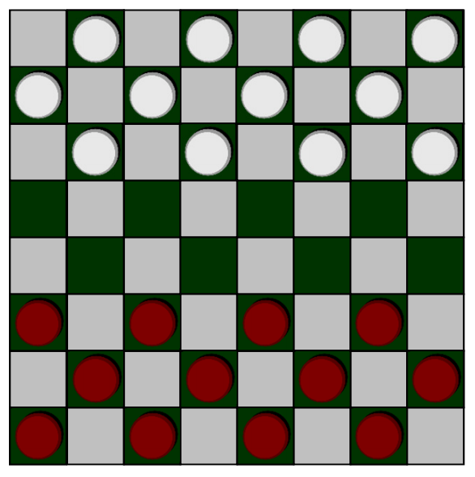
Machine Learning Algorithm

Slide 14
Machine Learning Algorithm
Supervised Learning
Unsupervised Learning
Others: Reinforcement learning, recommender systems

Slide 15
1. Supervised Machine Learning
Supervised learning is the machine learning task of inferring a function from labeled training data.
The training data consist of a set of training examples. In supervised learning, each example is a pair consisting of an input object (typically a vector) and a desired output value (also called the supervisory signal).
https://en.wikipedia.org/wiki/Supervised_learning
Notes:
Inferring output for a given input based on past input/output data.

Slide 16
Supervised Machine Learning
Housing Price
500
Price ($)
In 1000’s
Predict the Price of a house based on size
400
300
200
500
1000
1500
2000
2500
Size in feet^2

Slide 17
Supervised Machine Learning
Housing Price
500
Price ($)
In 1000’s
400
300
200
500
1000
1500
2000
2500
Size in feet^2

Slide 18
Supervised Machine Learning
Housing Price
500
Price ($)
In 1000’s
400
300
200
500
1000
1500
2000
2500
Size in feet^2

Slide 19
Supervised Machine Learning
Housing Price
500
Price ($)
In 1000’s
400
300
200
500
1000
1500
2000
2500
Size in feet^2

Slide 20
Supervised Machine Learning
Housing Price
500
Price ($)
In 1000’s
400
300
200
500
1000
1500
2000
2500
Size in feet^2

Slide 21
Supervised Machine Learning
Housing Price
500
Price ($)
In 1000’s
400
300
200
500
1000
1500
2000
2500
Size in feet^2

Slide 22
Supervised Machine Learning
Housing Price
500
Price ($)
In 1000’s
400
300
200
500
1000
1500
2000
2500
Size in feet^2

Slide 23
Supervised Machine Learning
Housing Price
500
Price ($)
In 1000’s
400
300
Regression: Predict continuous valued output (price)
200
500
1000
1500
2000
2500
Size in feet^2

Slide 24
Supervised Machine Learning
Cancer detection
Cancer detection based on size of Tumor
Malignant?
1(Y)
Classification: Discrete valued output (0 or 1)
0(N)
Size Of tumor

Slide 25



Slide 26
Supervised Machine Learning
Housing Price
500
Price ($)
In 1000’s
400
300
200
500
1000
1500
2000
2500
Size in feet^2

Slide 27



Supervised Machine Learning
Housing Price (Regression Problem)
500
Price ($)
In 1000’s
400
$$y\left(x\right)=c+ θx$$
$$θ$$
300
200
$$c$$
500
1000
1500
2000
2500
Size in feet^2

Slide 28

Supervised Machine Learning
Housing Price (Regression Problem)
500
Price ($)
In 1000’s
400
$$y\left(x\right)=c+ θx$$
OR
300
$$h_{θ}\left(x\right)=c+ θx$$
200
500
1000
1500
2000
2500
Size in feet^2

Slide 29
Supervised Machine Learning
Housing Price (Regression Problem)
500
Price ($)
In 1000’s
400
$$y\left(x\right)=c+ θx$$
OR
300
$$h_{θ}\left(x\right)=c+ θx$$
200
500
1000
1500
2000
2500
Hypothesis Function
Size in feet^2

Slide 30
Supervised Machine Learning
Housing Price (Regression Problem)
500
Price ($)
In 1000’s
400
$$y\left(x\right)=c+ θx$$
OR
300
$$h_{θ}\left(x\right)=c+ θx$$
200
500
1000
1500
2000
2500
Feature
Size in feet^2

Slide 31
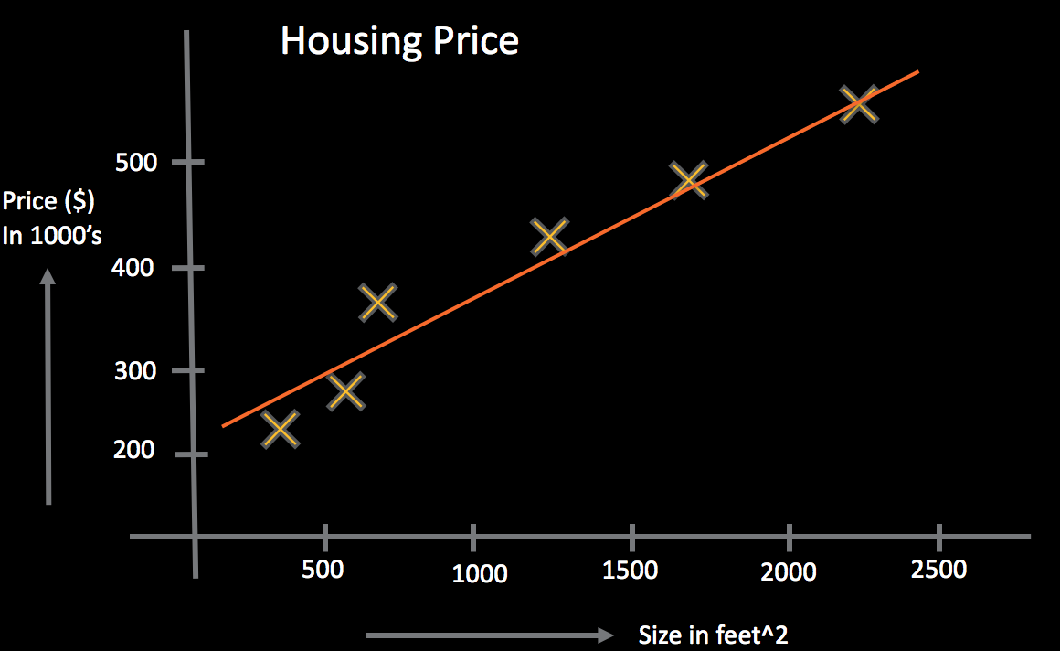

Supervised Machine Learning
$$h_{θ}\left(x\right)=c+ θx$$
How to find the best constant and theta?

Slide 32

Supervised Machine Learning
$$h_{θ}\left(x\right)=θ_{0}+ θ_{1}x$$
How to find the best theta?

Slide 33


Supervised Machine Learning
$$h_{θ}\left(x\right)=θ_{0}+ θ_{1}x$$
If $y(x)$ is the real solution -

Slide 34

Supervised Machine Learning
$$h_{θ}\left(x\right)=θ_{0}+ θ_{1}x$$
If $y(x)$ is the real solution -
$$h_{θ}\left(x\right)−y(x)$$
Objective is to Minimize

Slide 35

Supervised Machine Learning
$$h_{θ}\left(x\right)=θ_{0}+ θ_{1}x$$
$$h_{θ}\left(x\right)−y(x)$$
Objective is to Minimize
OR
$${(h_{θ}\left(x\right)−y\left(x\right))}^{2}$$

Slide 36


Supervised Machine Learning
$$h_{θ}\left(x\right)=θ_{0}+ θ_{1}x$$
$$h_{θ}\left(x\right)−y(x)$$
Objective is to Minimize
OR
$${(h_{θ}\left(x\right)−y\left(x\right))}^{2}$$
$$\sum_{x=1}^{m}{{(h_{θ}\left(x\right)−y\left(x\right))}^{2}}$$
=> For all x

Slide 37
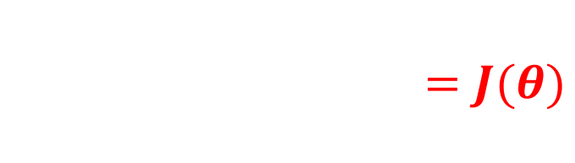
Supervised Machine Learning
$$h_{θ}\left(x\right)=θ_{0}+ θ_{1}x$$
$$h_{θ}\left(x\right)−y(x)$$
Objective is to Minimize
$${(h_{θ}\left(x\right)−y\left(x\right))}^{2}$$
$$\sum_{x=1}^{m}{{(h_{θ}\left(x\right)−y\left(x\right))}^{2}=J(θ)}$$
Cost Function

Slide 38


Supervised Machine Learning
$$\sum_{x=1}^{m}{{(h_{θ}\left(x\right)−y\left(x\right))}^{2}=J(θ)}$$
Objective: To minimize $J(θ)$

Slide 39


Supervised Machine Learning
$$\sum_{x=1}^{m}{{(h_{θ}\left(x\right)−y\left(x\right))}^{2}=J(θ)}$$
Objective: To minimize $J(θ)$
$$\frac{d(J(θ))}{d(θ)}=0$$
*** Changes in $J(θ)$ in respect to $θ$

Slide 40
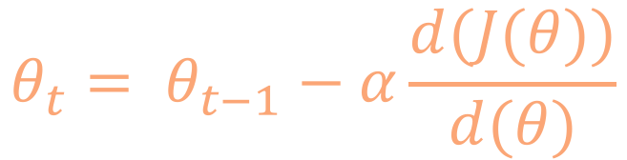
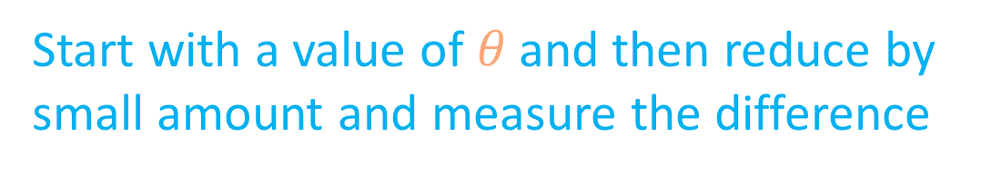
Supervised Machine Learning
$$\sum_{x=1}^{m}{{(h_{θ}\left(x\right)−y\left(x\right))}^{2}=J(θ)}$$
Objective: To minimize $J(θ)$
$$θ_{t}= θ_{t−1}−α\frac{d(J(θ))}{d(θ)}$$
Start with a value of $θ$and then reduce by
small amount and measure the difference
At time t
At time t-1
Reduction

Slide 41
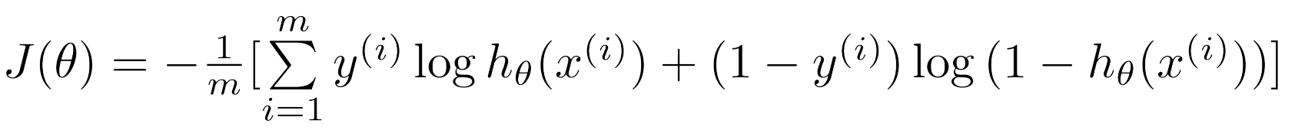
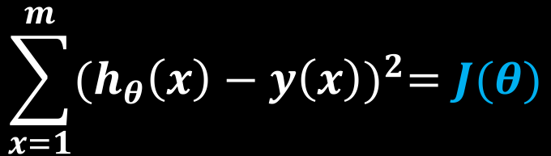

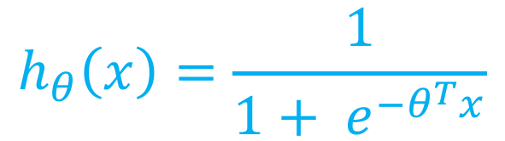

Supervised Machine Learning
Linearregression
$$\sum_{x=1}^{m}{{(h_{θ}\left(x\right)−y\left(x\right))}^{2}=J(θ)}$$
Objective: To minimize $J(θ)$
$$h_{θ}\left(x\right)=θ_{0}+ θ_{1}x$$
$$θ_{t}= θ_{t−1}−α\frac{d(J(θ))}{d(θ)}$$
$$h_{θ}\left(x\right)=\frac{1}{1+ e^{−θ^{T}x}}$$
Gradient Decent (Logistic regression)

Slide 42

Visual
Representation

Slide 43


Gradient Decent
Cost
Cost
$$θ$$
$$θ$$

Slide 44
Gradient Decent
Cost
Cost
$$θ$$
$$θ$$
Notes:
Varying kinds and degrees of intelligence occur in people, many animals and some machines

Slide 45
Gradient Decent
Cost
Cost
$$θ$$
$$θ$$
Notes:
Varying kinds and degrees of intelligence occur in people, many animals and some machines

Slide 46
Gradient Decent
Cost
Cost
$$θ$$
$$θ$$
Notes:
Varying kinds and degrees of intelligence occur in people, many animals and some machines

Slide 47
Gradient Decent
Cost
Cost
$$θ$$
$$θ$$
Notes:
Varying kinds and degrees of intelligence occur in people, many animals and some machines

Slide 48
Supervised Learning
Support Vector Machine (SVM)
Decision Tree (DT)
Logistic Regression (LR)
Neural Network

Slide 49
2. Unsupervised Learning
Unsupervised learning is a type of machine learning algorithm used to draw inferences from datasets consisting of input data without labeled responses.

Slide 50
Unsupervised Learning - Clustering
X2
X1
Notes:
Varying kinds and degrees of intelligence occur in people, many animals and some machines

Slide 51
Unsupervised Learning - Clustering
X2
X1
Notes:
Varying kinds and degrees of intelligence occur in people, many animals and some machines

Slide 52
Unsupervised Learning -Application

Slide 53
Unsupervised Learning -Application

Slide 54
Supervised Learning
K-means Clustering
Non Negative Matrix Factorization (NMF)

Slide 55
ML - Pipeline

Slide 56
ML - Pipeline
Labeled Data
Input
Output

Slide 57
ML - Pipeline
Labeled Data
Features
Input
Output

Slide 58
ML - Pipeline
Labeled Data
Features
Split
Input
Output

Slide 59
ML - Pipeline
Labeled Data
Features
Split
Input
Output
ML Algorithms
Models
Model
Model

Slide 60
ML - Pipeline
Labeled Data
Features
Split
Input
Output
Training
ML Algorithms
Test Data
Models
Model
Model
Model
Test/Measure

Slide 61
ML - Pipeline
Labeled Data
Features
Split
Input
Output
Training
ML Algorithms
Test Data
Models
Model
Model
Live Input
Predicted Output
Run
Model
Test/Measure

Slide 62
ML - Pipeline
Labeled Data
Features
Split
Input
Output
Training
ML Algorithms
Test Data
Models
Model
Model
Live Input
Predicted Output
Run
Model
Test/Measure

Slide 63
ML – Model Performance Measurement

Slide 64
ML – Model Performance Measurement
https://en.wikipedia.org/wiki/Receiver_operating_characteristic

Slide 65
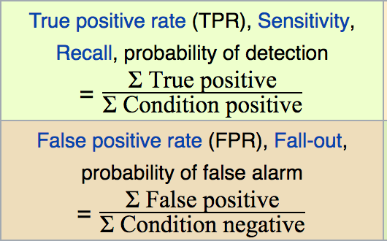
ML – Model Performance Measurement
https://en.wikipedia.org/wiki/Receiver_operating_characteristic

Slide 66
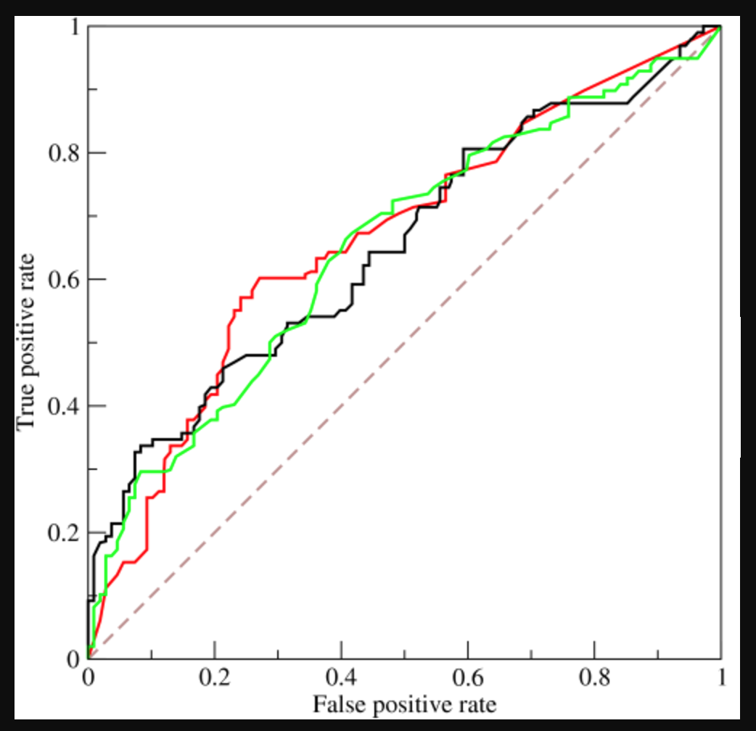
ML – Model Performance Measurement
ROC :
Receiver operating characteristic
https://en.wikipedia.org/wiki/Receiver_operating_characteristic

Slide 67
How?

Slide 68

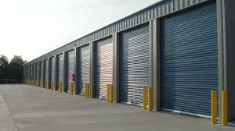
Big-Data
Processing Resource
Storage Resource

Slide 69
Big-Data– Why?
Problems need to be solved
Store massive amounts of data in a cost-effective way
Process the data efficiently and fast
Constraints
Limited storage capability per machine
Limited processing capability per machine

Slide 70
Big-Data - Hadoop

Slide 71
Big-Data - Hadoop
Processing Resource
Storage Resource
Map-Reduce
HDFS

Slide 72
Problem with Hadoop Map-Reduce
Lots of Disk I/O
Not taking advantage memory
In efficient networking between data nodes
Unnatural Programming Paradigm
Mostly good for batch processing not much real-time
Notes:
General Purpose

Slide 73

Introducing Apache Spark

Slide 74
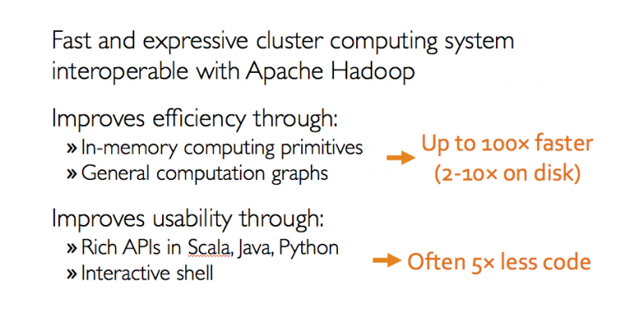
What is Apache Spark
Notes:
General Purpose

Slide 75
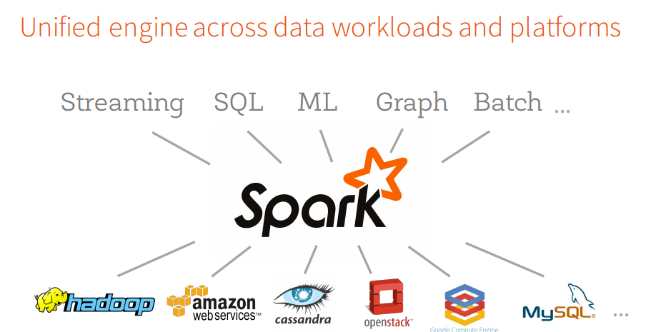
Apache Spark
Notes:
General Purpose

Slide 76

Apache Spark
Notes:
General Purpose

Slide 77
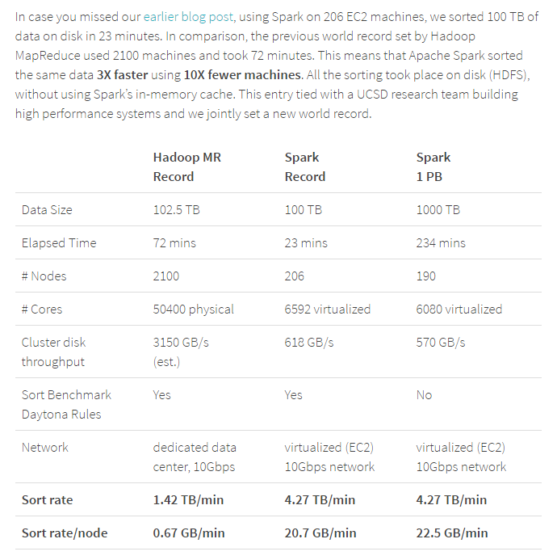
Apache Spark
Notes:
General Purpose

Slide 78
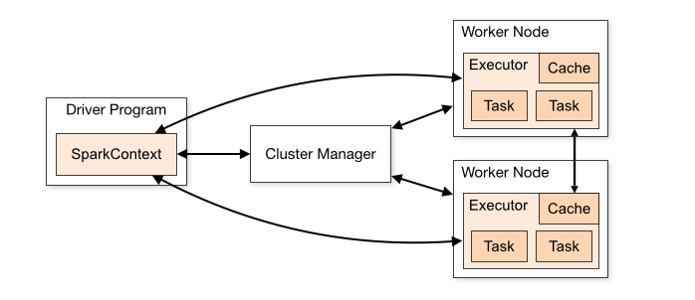
Apache Spark - Architecture
Spark Context
Notes:
General Purpose

Slide 79
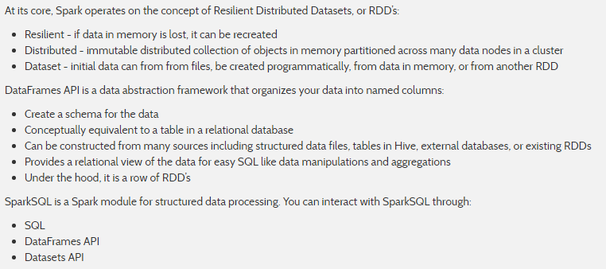
Spark RDDs – DataFrames - SparkSQL
Notes:
General Purpose

Slide 80
Spark RDDs – DataFrames - SparkSQL
Distributed Array of Data
RDD with Schema
RDD + Schema + SQL
Notes:
General Purpose

Slide 81
Where?

Slide 82
Setup – Environment and Software
Apache Spark
Hadoop Yarn, Mesos, Standalone (for development/testing)
Scala/Python and SBT
IntelliJ/Any-IDE
Command line tools

Slide 83
Let’s do it !!!

Slide 84
Where is domain?

Slide 85
Predict Patient mortality
Patient events data
Drug
Lab result
Diagnosis code
Patient’s mortality info

Slide 86
Index date and Prediction Window
Dead Patient
Live Patient
Time

Slide 87
Index date and Prediction Window
Date of Death
Dead Patient
Last Event Date
Live Patient
Time

Slide 88
Index date and Prediction Window
Date of Death
Index Date
30 days
Dead Patient
Index Date
Live Patient
Time

Slide 89
Index date and Prediction Window
Date of Death
Prediction Windows
Index Date
2000 days
30 days
Dead Patient
Index Date
Prediction Windows
2000 days
Live Patient
Time

Slide 90
Lets see some code

Slide 91
Thank You
Email: joychak1@[yahoo/gmail].com]

